Slide 2
Xamarin With Xamarin.Forms3.0
Abhishek Kumar
Software Engineer

Slide 3
Architecting mobile apps

Slide 4
Silo approach
iOS
Android
Windows
Objective-C/Swift
Xcode
Java
Android Studio
C#
Visual Studio
No shared code • Many languages and development environments • Multiple teams

Slide 5
Write once, run anywhere
Lua
Javascript
Actionscript
HTML+CSS
App generator
Limited native API access • Slow performance • Poor user experience

Slide 6
Xamarin’s unique approach
iOS C# UI
Android C# UI
Windows C# UI
Shared C# logic
Shared C# codebase • 100% native API access • High performance

Slide 7
What is native?

Slide 8
?
?
?
Native UI
Native APIs
Native
Performance

Slide 9
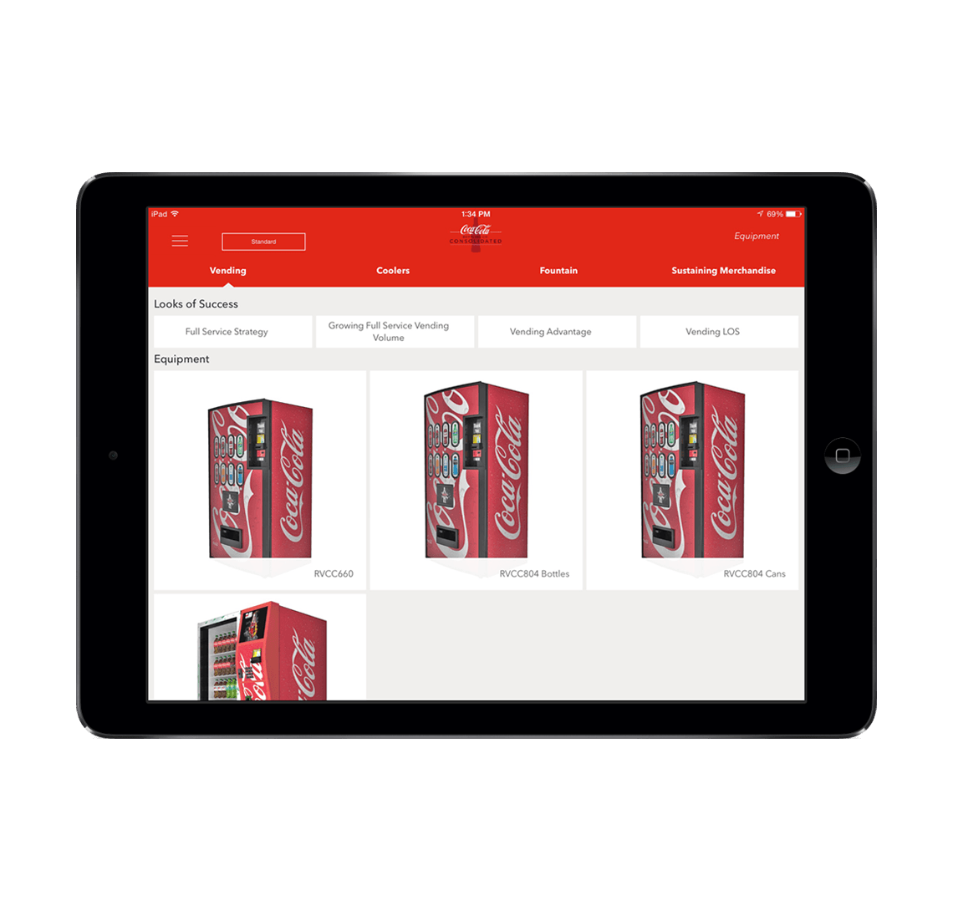
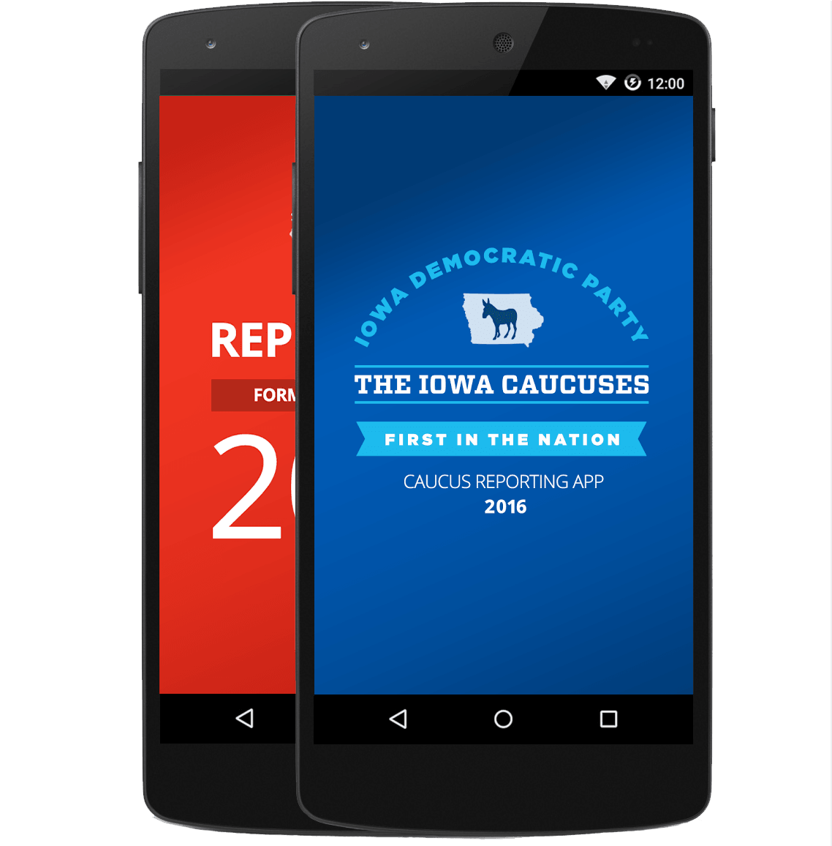

Xamarin.Forms approach
Shared UI Code
Shared C# Logic
Shared User Interface
Shared App Logic

Slide 10
Xamarin + Xamarin.Forms
iOS C# UI
Android C# UI
Windows C# UI
Xamarin.Forms
Shared C# Logic
Shared C# Logic
Traditional Xamarin approach
With Xamarin.Forms: More code-sharing, all native

Slide 11
What’s included
✓ 40+ Pages, layouts, and controls
(Build from code behind or XAML)
✓ Two-way data binding
✓ Navigation
✓ Animation API
✓ Dependency Service
✓ Messaging Center
Shared UI Code
Shared C# Backend

Slide 12

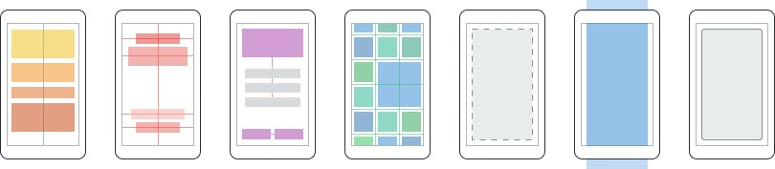
Layouts
Pages
Content
MasterDetail
Navigation
Tabbed
Carousel
Stack
Absolute
Relative
Grid
ContentView
ScrollView
Frame
Notes:
Inside of a page are layouts
A lot of options from something simple like a stack panel to complex and powerful grids

Slide 13
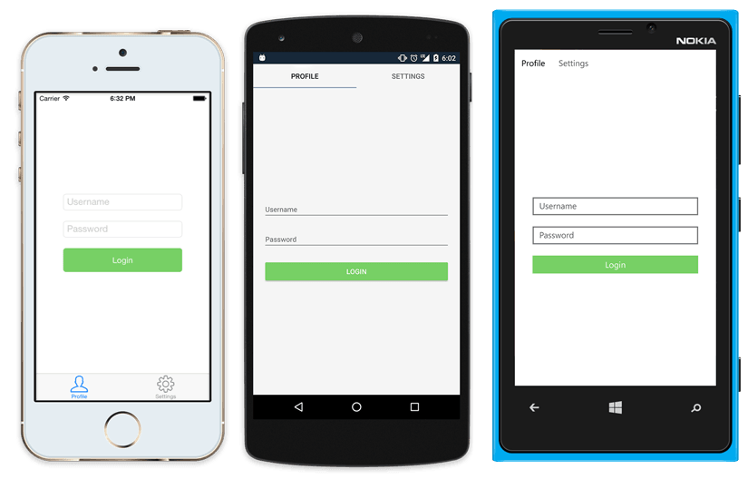
Native UI from shared code
<?xml version="1.0" encoding="UTF-8"?>
<TabbedPage xmlns="http://xamarin.com/schemas/2014/forms"
xmlns:x="http://schemas.microsoft.com/winfx/2009/xaml"
x:Class="MyApp.MainPage">
<TabbedPage.Children>
<ContentPage Title="Profile" Icon="Profile.png">
<StackLayout Spacing="20" Padding="20"
VerticalOptions="Center">
<Entry Placeholder="Username"
Text="{Binding Username}"/>
<Entry Placeholder="Password"
Text="{Binding Password}"
IsPassword="true"/>
<Button Text="Login" TextColor="White"
BackgroundColor="#77D065"
Command="{Binding LoginCommand}"/>
</StackLayout>
</ContentPage>
<ContentPage Title="Settings" Icon="Settings.png">
<!-- Settings -->
</ContentPage>
</TabbedPage.Children>
</TabbedPage>

Slide 14
Benefits
✓ Easy to Manage code
✓ Single UI for all platform
✓ 100% Code Sharing
✓ See XAML error at build time

Slide 15
What’s New in Xamarin.Forms 3.0

Slide 16
Main Features in Xamarin 3.0
Visual State Manger
Right-To-Left
FlexLayout
CSS

Slide 17
Visual State Manger
<Entry FontSize="18">
<VisualStateManager.VisualStateGroups>
<VisualStateGroup x:Name="CommonStates">
</VisualStateGroup>
</VisualStateManager.VisualStateGroups>
</Entry>
VisualElement "CommonStates"
"Normal"
"Disabled"
"Focused"

Slide 18
Visual State Manger
<Entry FontSize="18">
<VisualStateManager.VisualStateGroups>
<VisualStateGroup x:Name="CommonStates">
</VisualStateGroup>
</VisualStateManager.VisualStateGroups>
</Entry>
VisualElement "CommonStates"
"Normal"
"Disabled"
"Focused"
.GoToState(this, "Focused");

Slide 19
<Entry FontSize="18">
<VisualStateManager.VisualStateGroups>
<VisualStateGroup x:Name="CommonStates">
<VisualState x:Name="Normal">
</VisualState>
<VisualState x:Name="Focused">
</VisualState>
<VisualState x:Name="Disabled">
</VisualState>
</VisualStateGroup>
</VisualStateManager.VisualStateGroups>
</Entry>
Visual State Manger
VisualElement "CommonStates"
"Normal"
"Disabled"
"Focused"
.GoToState(this, "Focused");

Slide 20
<Entry FontSize="18">
<VisualStateManager.VisualStateGroups>
<VisualStateGroup x:Name="CommonStates">
<VisualState x:Name="Normal">
<VisualState.Setters>
<Setter Property="BackgroundColor" Value="Lime" />
</VisualState.Setters>
</VisualState>
<VisualState x:Name="Focused">
<VisualState.Setters>
<Setter Property="FontSize" Value="36" />
</VisualState.Setters>
</VisualState>
<VisualState x:Name="Disabled">
<VisualState.Setters>
<Setter Property="BackgroundColor" Value="Pink" />
</VisualState.Setters>
</VisualState>
</VisualStateGroup>
</VisualStateManager.VisualStateGroups>
</Entry>
Visual State Manger
VisualElement "CommonStates"
"Normal"
"Disabled"
"Focused"
.GoToState(this, "Focused");

Slide 21
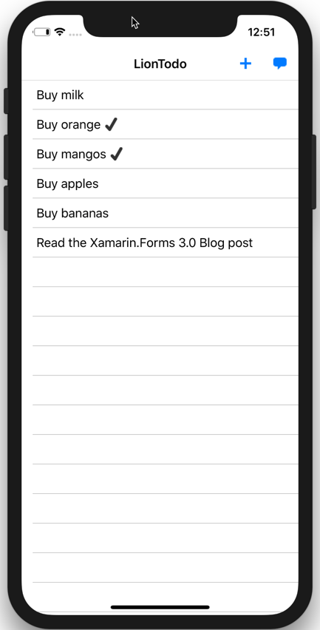
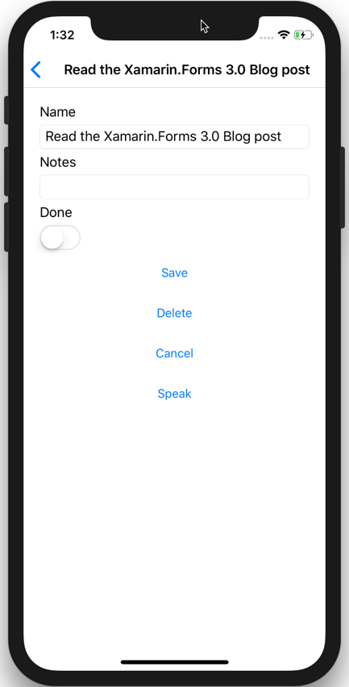
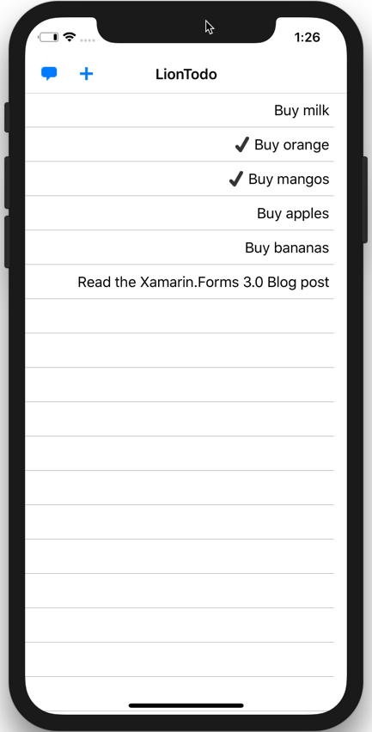
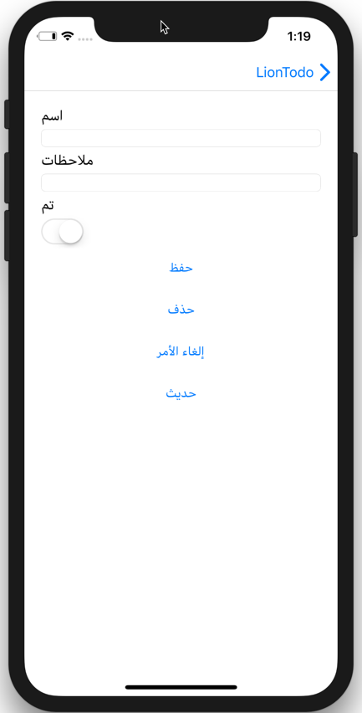
Right-To-Left
Left-To-Right
Right-To-Left
Config iOS :
Info.plist
<key>CFBundleDevelopmentRegion</key>
<string>en</string>
<key>CFBundleLocalizations</key>
<array>
<string>en</string>
<string>ar</string>
</array>
Config Android :
Package.appxmanifest
<Resource Language="en" />
<Resource Language="ar" />
FlowDirection="{x:Static Device.FlowDirection}"

Slide 22
FlexLayout
Flexible
Alignment and Adapting to various screens
Reducing UI nesting

Slide 23
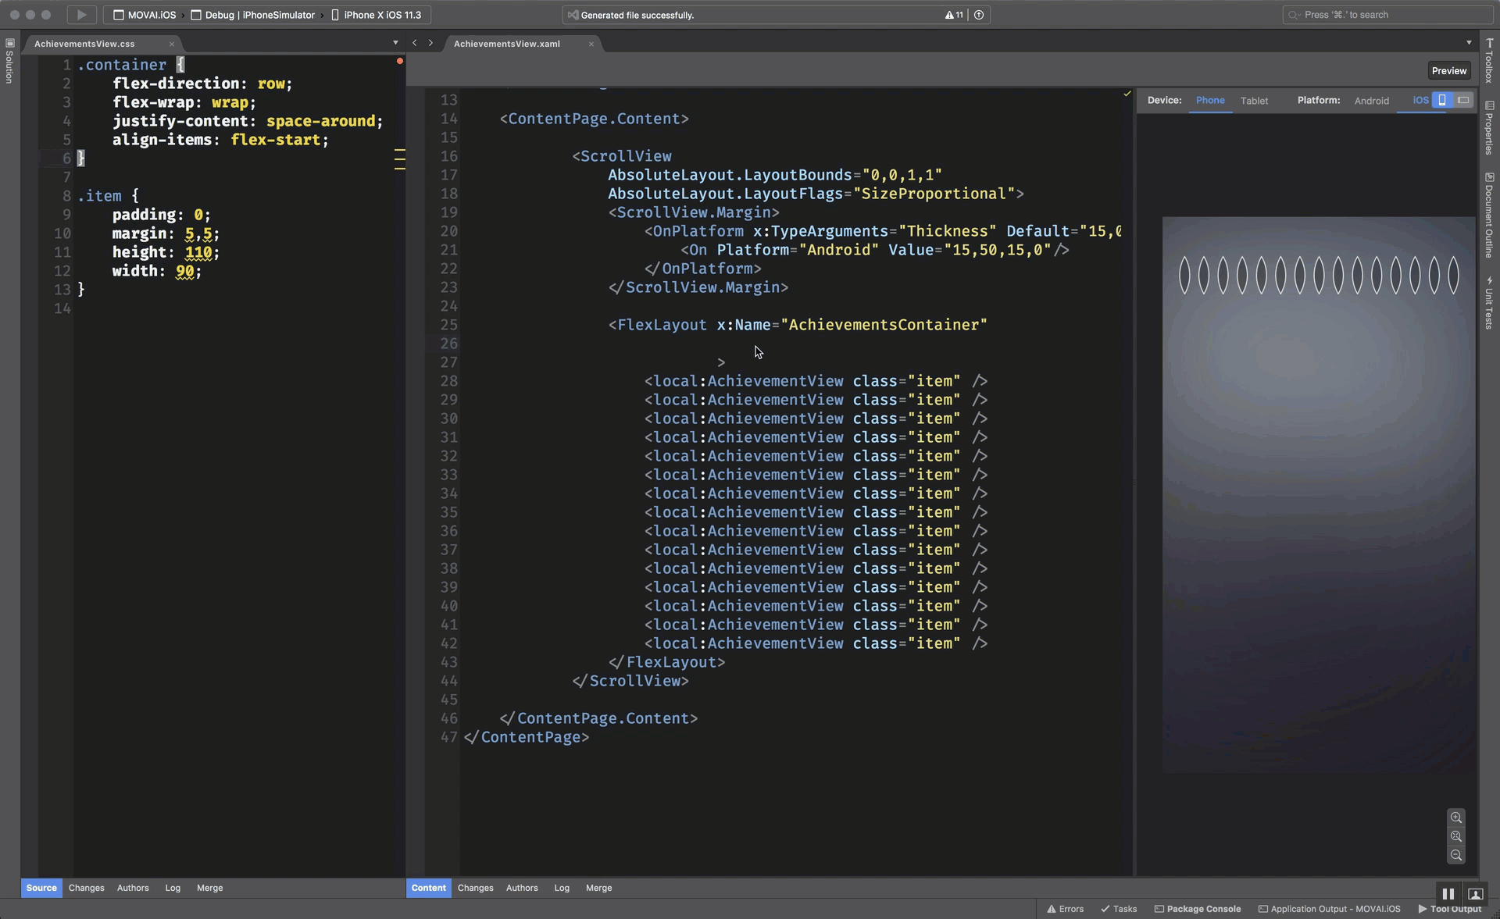

Slide 24
Cascading Style Sheets (CSS)
Styles working via CSS
Parsed in runtime
Not Replace XAML Styles
Support many properties

Slide 25
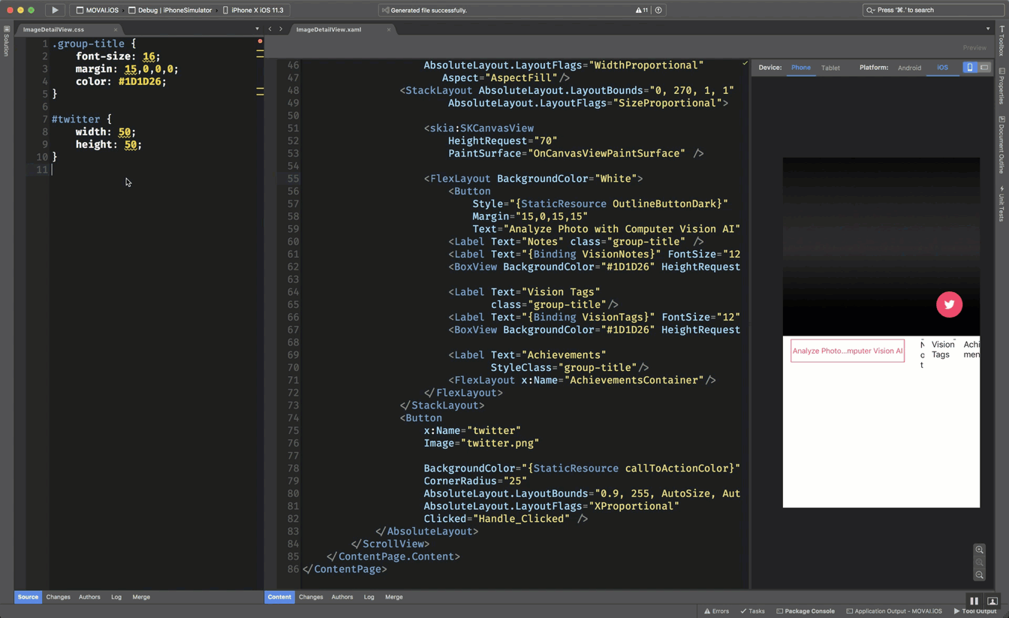

Slide 26
Little Things

Slide 27
F100: Addressing the Little Things
Project Board
Entry/Editor
IsSpellCheckEnabled
MaxLength
DetectReadingOrderFromContent (UWP)
Text prediction options
Autocapitalization
AutoResizable Editor
ButtonType for return button
Position and Color of caret
Placeholder color
Label
Bindable Spans
Commandable Spans, Span Gestures
LineHeight
ListView
full width separators
SelectionMode
SearchBar IsSpellCheckEnabled
ImeOptions
DesignModeEnabled
Android Bottom Tabs
WebView mixed content (Android)
WebView evaluate javascript
Binding Mode OneTime
ProgressBar colors
Switch colors
Slider colors
Hide scroll bars
Button AccessKey
TabbedPage Icons (UWP)
Drop Shadows (iOS/UWP)
App DI Container Hooks
Button Padding
Page TitleView
BoxView rounded corners
WKWebView for iOS
Coming Soon
Label MaxLines
Entry Read-Only
ImageButton
GIF Support
Button and Label Parity
PinsSource on Forms.Map
WebView Zoom Controls (Android)
Help Wanted
Rounded Corners
Rounded Image
ProgressBar.Height
InkWell Ripple Effect
Size WebView to Content
Floating Action Button
Android Theme Capitalization override

Slide 28
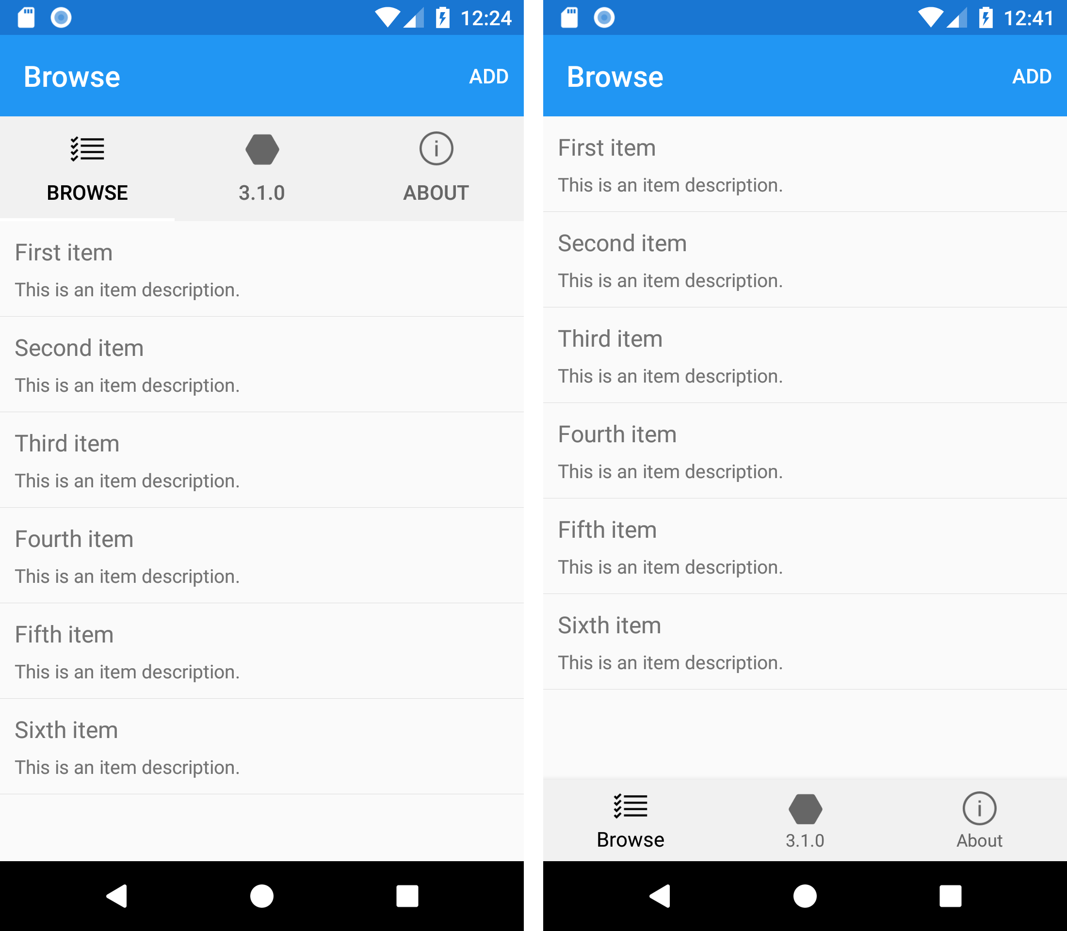
Android Bottom Tab
1 2 3 4 5 6 7 8 9 | <TabbedPage … BarBackgroundColor="#F1F1F1" xmlns:android="clr-namespace:Xamarin.Forms.PlatformConfiguration.AndroidSpecific;assembly=Xamarin.Forms.Core" android:TabbedPage.ToolbarPlacement="Bottom" android:TabbedPage.BarItemColor="#666666" android:TabbedPage.BarSelectedItemColor="Black">

Slide 29
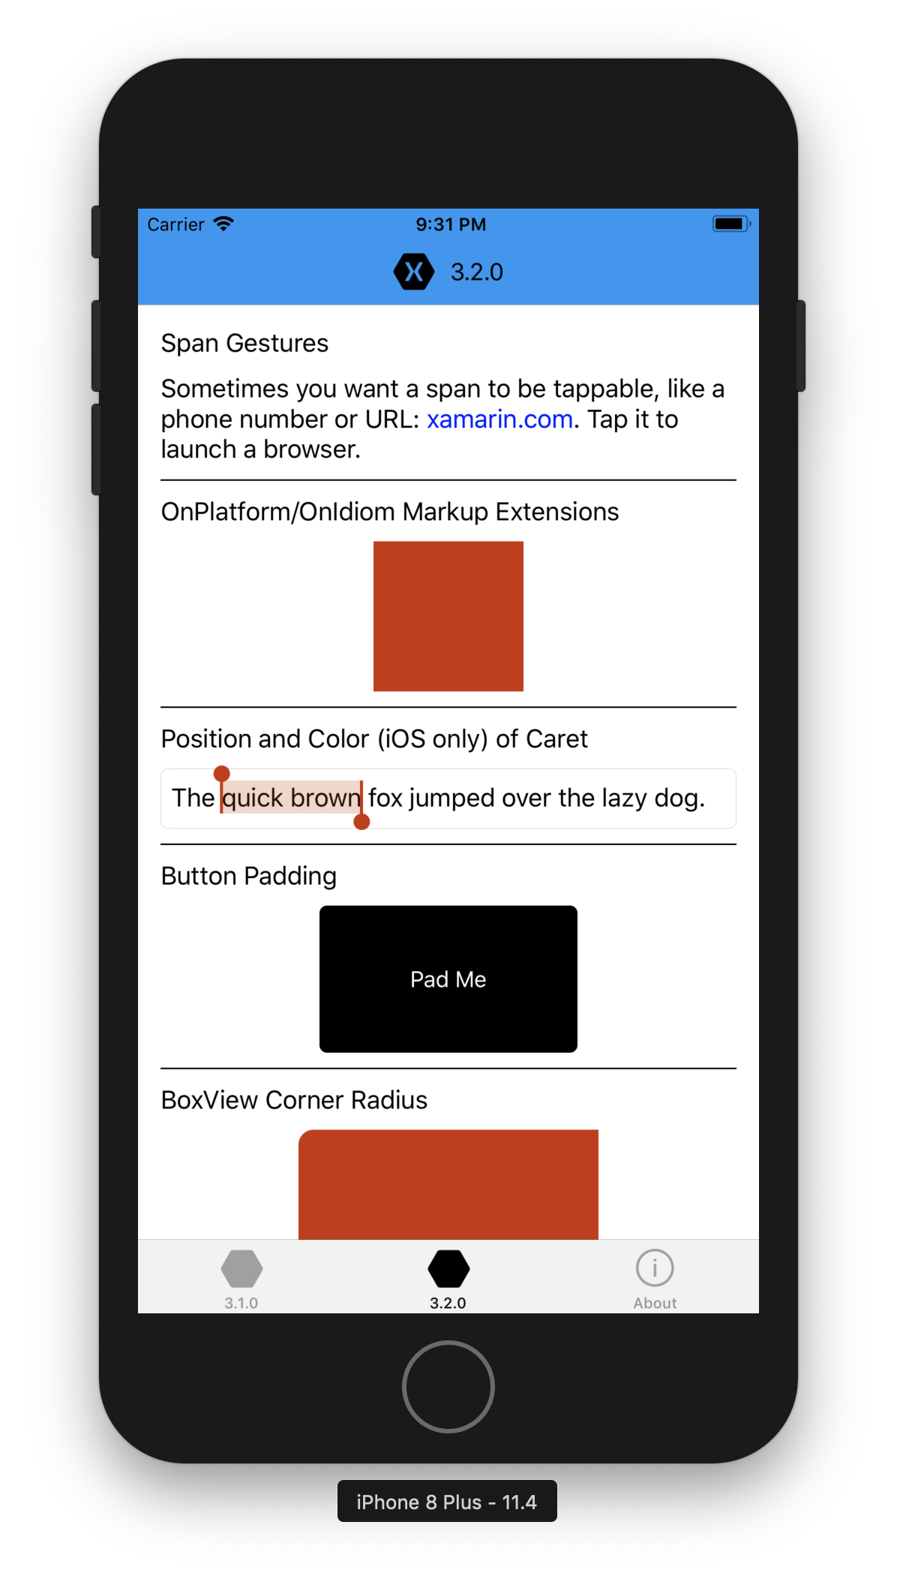
TitleView
<ContentPage>
<NavigationPage.TitleView>
<StackLayout
Orientation="Horizontal"
VerticalOptions="Center" Spacing="10">
<Image Source="iconXamagon.png">
<Image.GestureRecognizers>
<TapGestureRecognizer
Tapped="Handle_Tapped"/>
</Image.GestureRecognizers>
</Image>
<Label Text="3.2.0"
FontSize="16"
TextColor="Black"
VerticalTextAlignment="Center" />
</StackLayout>
</NavigationPage.TitleView>
...
</ContentPage>

Slide 30
Bindable Span
<Label> <Label.FormattedText> <FormattedString> <Span Text="Welcome " /> <Span Text="{Binding YourName}" FontAttributes="Bold"/> <Span Text=" to the Xamarin.Forms 3.1.0 playground!" /> </FormattedString> </Label.FormattedText> </Label>

Slide 31
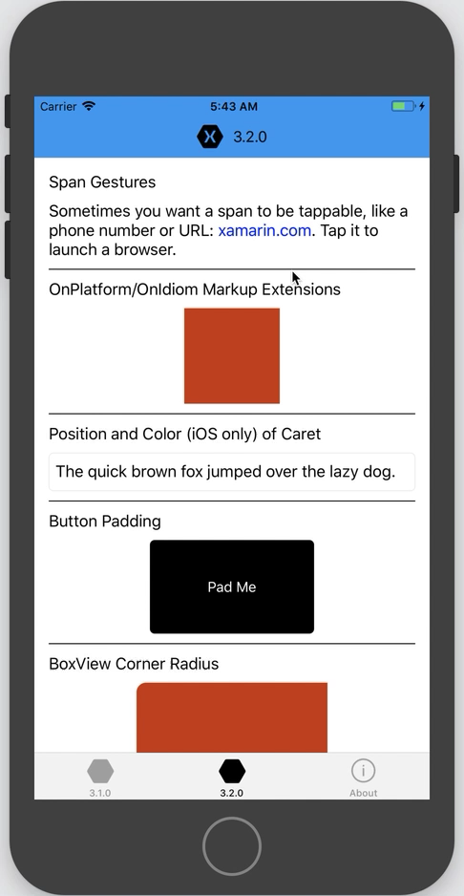
Commandable Span Gestures
<Label>
<Label.FormattedText>
<FormattedString>
<Span Text="Sometimes you want a span to be tappable, like a phone number or URL: " />
<Span Text="{Binding Url, Mode=OneWay}" TextColor="Blue">
<Span.GestureRecognizers>
<TapGestureRecognizer
Command="{Binding TapCommand, Mode=OneWay}"
CommandParameter="https://www.xamarin.com"/>
</Span.GestureRecognizers>
</Span>
<Span Text=". Tap it to launch a browser."/>
</FormattedString>
</Label.FormattedText>
</Label>

Slide 32

Button Padding
<Button Text="Pad Me" Padding="60,40" BackgroundColor="Black" TextColor="White"/>

Slide 33
Q&A

Slide 34
Thanks!
abhishabd1@gmail.com
@abhishabd1

